Slide 1

Linux in Detail

Slide 2
Linux in Detail
This is “Tux”, the Linux mascot. It was originally created as an entry to a Linux logo competition. Tux is the most commonly used icon for Linux.

Slide 3
Linux in Detail
Let’s look at:
Processor Management
File Management
Memory Management
Device Management
Command Line Interface
Notes:
https://en.wikipedia.org/wiki/Linux_kernel

Slide 4
Processor Management

Slide 5
Linux: Processor Management
Process
5
Process
4
Process
3
Process
2
Process
1
Job Scheduler
Process Scheduler

Slide 6
Linux: Processor Management
JOB SCHEDULER
HOLD
FINISHED
PROCESS SCHEDULER
READY
RUNNING
WAITING

Slide 7
Linux: Processor Management
fork()
Linux uses the same parent-child process management found in Unix, centring on the fork() command.
fork() gives the user to create a copy of an executing program.
This command gives the second program all the attributes of the first program, such as any open files, and saves the first program in its original form.
Notes:
https://en.wikipedia.org/wiki/Linux_kernel

Slide 8
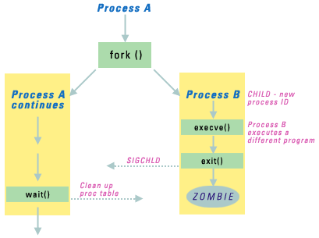
Linux: Processor Management
Notes:
https://en.wikipedia.org/wiki/Linux_kernel

Slide 9
Linux: Processor Management
The system call fork() splits a program into two copies, which are both running from the statement after the fork command.
The original process (Process A) is called the parent process and the resulting process (Process B) is the child process. A child inherits the parent’s open files.
When fork() is executed, the child process gets a new process ID (called PID for short), this is done in a way that ensures that each process has its own unique ID number.
Notes:
https://en.wikipedia.org/wiki/Linux_kernel

Slide 10
Linux: Processor Management
exec()
The exec family of commands—execl(), execv(), execle(), execlp(), and execlvp()—is used to start execution of a new program from another program. Unlike fork(), which results in two processes running the same program in memory, a successful exec() call will lay the second program over the first, leaving only the second program in memory.
So, exec() changes what the program is doing but doesn’t change the process ID (PID).
Notes:
https://en.wikipedia.org/wiki/Linux_kernel

Slide 11

Linux: Processor Management
So often you do a fork() followed by an exec() on the child process…
Notes:
https://en.wikipedia.org/wiki/Linux_kernel

Slide 12
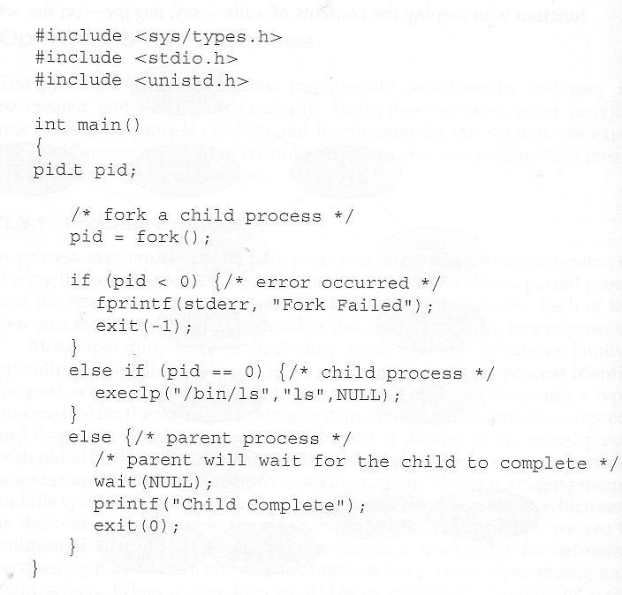
Linux: Processor Management
Notes:
https://en.wikipedia.org/wiki/Linux_kernel

Slide 13
Linux: Processor Management
The Linux process scheduler typically scans the list of processes in the READY state and, using predefined criteria, chooses which process to execute.
The scheduler has three different scheduling types: two for real-time processes and one for normal processes.
Notes:
https://en.wikipedia.org/wiki/Linux_kernel

Slide 14
Linux: Processor Management
Name | Priority Level | Process Type | Scheduling Policy
SCHED_FIFO | Highest Priority | For non-pre-emptiable real-time processes. | First In, First Out (FIFO)
SCHED_RR | Medium Priority | For pre-emptiable real-time processes. | Round Robin and priority
SCHED_OTHER | Lowest Priority | For normal processes. | Priority only
Notes:
https://en.wikipedia.org/wiki/Linux_kernel

Slide 15
File Management

Slide 16
Linux: File Management
Linux is case sensitive, so the following are different files:
README.TXT
ReadMe.TXT
readMe.TXT
readme.TXT
Notes:
https://en.wikipedia.org/wiki/Linux_kernel

Slide 17
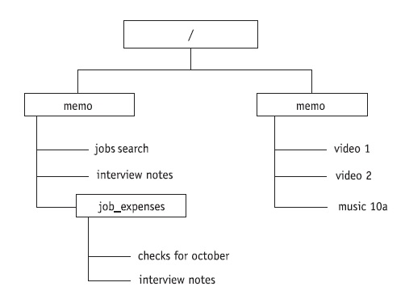
Linux: File Management
A typical Linux file structure
Notes:
https://en.wikipedia.org/wiki/Linux_kernel

Slide 18
Linux: File Management
Filenames can be up to 255 characters long and can contain alphabetic characters, underscores, and numbers.
File suffixes (which is the Linux term for file extensions) are optional.
Filenames can include a space; however, this can cause complications if you’re running programs from the command line because a program named interview notes would be viewed as a command to run two files: interview and notes. To avoid confusion, the two words can be enclosed in quotes: “interview notes.”
Notes:
https://en.wikipedia.org/wiki/Linux_kernel

Slide 19
Linux: File Management
The full filename includes path information:
/Office/Powerpoint/LinuxInDetail.ppt
root
path
Filename
suffix

Slide 20
Linux: File Management
In Linux the Access Controls are:
R: Read
W: Write
X: Execute

Slide 21
Linux: File Management
In Linux access to a file can assigned to one of three groups:
User
User Group
World

Slide 22
Linux: File Management
In Linux access to a file can assigned to one of three groups:
User – you
User Group – everyone in your group
World – everyone with a login to the system

Slide 23
Linux: File Management
In Linux access to a file can assigned to one of three groups:
-rwxrwxrwx
User User-Group World

Slide 24
Linux: File Management
In Linux access to a file can assigned to one of three groups:
-rwxrwxrwx
-111111111

Slide 25
Linux: File Management
In Linux access to a file can assigned to one of three groups:
-rwxrwxrwx
User User-Group World

Slide 26
Modifying Permissions
Symbolic mode | Octal mode
rwx | 7 (4+2+1)
r-x | 5 (4+0+1)
rw- | 6 (4+2+0)
Syntax for modifying permissions is as follows
chmod [OPTIONS] NUMBER FILE...
Syntax for modifying permissions is as follows
The NUMBER flag represents the three-digit value, each digit (0 - 7) representing permission for one category of users.
Let’s see the corresponding value for each permission:
4 means read permission.
2 is for write permission.
1 represents execute permission.
0 for no permission.

Slide 27
Linux: File Management
If we want to grant permissions to file, e.g. MakeABackup.sh, we do:
chmod 755 MakeABackup.sh
chmod 777 MakeABackup.sh
chmod 700 MakeABackup.sh

Slide 28

Quiz
Imagine we had a file called `example.md`, Grant the read and write permissions to the owner of example.md and only read permission to group members and all other users.
What would the chmod command look like?

Slide 29
Memory Management

Slide 30

Linux: Memory Management
Linux allocated 1GB for the kernel, and 3GB for executing processes.
The 3GB address space is divided into:
Process code
Process data
Shared library data used by processes
Stack used by process
Notes:
https://en.wikipedia.org/wiki/Linux_kernel

Slide 31
Linux: Memory Management
When thinking about virtual memory we’ll remember that the operating system divides a process into pages, and it divides main memory into page frames.
Main
Memory
Process
Operating
System
Memory
Program 4:
350 bytes
Page 0
Page 1
Page 2
Page 2
Page 3
Page 0
Page 1
Page 3

Slide 32
Linux: Memory Management
When a process requests pages, Linux loads them into memory.
When the kernel needs memory space, the pages are released on a Least-Recently Used (LRU) basis.
To keep track of free and busy pages, Linux uses a system of page tables.
Notes:
https://en.wikipedia.org/wiki/Linux_kernel

Slide 33
Linux: Memory Management
Each virtual address in memory is stored as four elements:
Main Directory
Middle Directory
Page Table Directory
Page Frame
Notes:
https://en.wikipedia.org/wiki/Linux_kernel

Slide 34
Linux: Memory Management
Each virtual address in memory is stored as four elements:
Main Directory
Middle Directory
Page Table Directory
Page Frame
Example
Page 1
Table 3
Page Table 2
Location of Line 214
Notes:
https://en.wikipedia.org/wiki/Linux_kernel

Slide 35
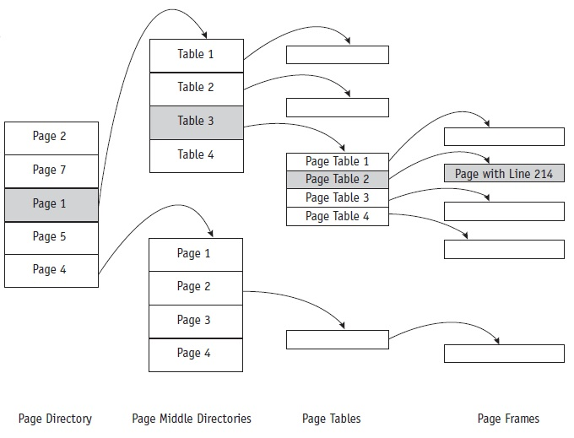
Linux: Memory Management
As a diagram
Notes:
https://en.wikipedia.org/wiki/Linux_kernel

Slide 36
Device Management

Slide 37
Linux: Device Management
Linux is device independent, which improves its portability from one system to another.
Device drivers supervise the transmission of data between main memory and the peripheral unit.
Notes:
https://en.wikipedia.org/wiki/Linux_kernel

Slide 38
Linux: Device Management
Linux treats devices as if they are files, and you can access devices the same way you access files in Linux.
Devices are assigned not only a name but also descriptors that further identify each device and are stored in the device directory.
Notes:
https://en.wikipedia.org/wiki/Linux_kernel

Slide 39
Linux: Device Management
A device driver (or driver) is a computer program that operates or controls a particular type of device that is attached to a computer.
A driver provides a software interface to hardware devices, enabling operating systems and other computer programs to access hardware functions without needing to know precise details of the hardware being used.
Notes:
https://en.wikipedia.org/wiki/Linux_kernel

Slide 40
Linux: Device Management
Linux identifies each device by a major device number and a minor device number.
the major device number identifies the driver associated with the device.
the minor device number is used by the kernel to determine exactly which device is being referred to.
Notes:
https://en.wikipedia.org/wiki/Linux_kernel

Slide 41
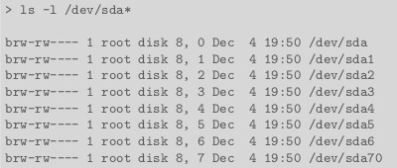
Linux: Device Management
Notes:
https://en.wikipedia.org/wiki/Linux_kernel

Slide 42

Linux: Device Management
Standard versions of Linux often provide a comprehensive collection of common device drivers; but if the computer system should include hardware or peripherals that are not on the standard list, their device drivers can be retrieved from another source and installed separately.
Alternatively, a computer programmer can write a device driver and install it for use.
Notes:
https://en.wikipedia.org/wiki/Linux_kernel

Slide 43
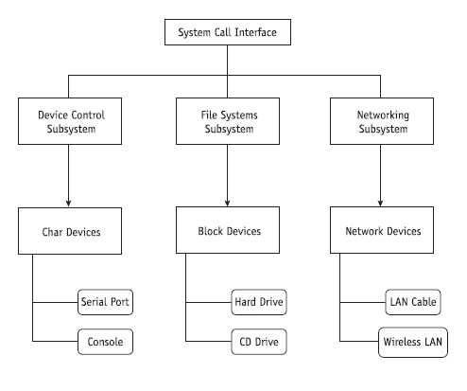
Linux: Device Management
Classes of device drivers
Notes:
https://en.wikipedia.org/wiki/Linux_kernel

Slide 44
Linux: Device Management
Char Devices: Character devices are those that can be accessed as a stream of bytes, such as a communications port, monitor, or other byte-stream-fed device.
Block Devices: Similar to char devices except that they can host a file system, such as a hard disk.
Network Devices: Their function is to send and receive packets of information as directed by the network subsystem of the kernel.
Notes:
https://en.wikipedia.org/wiki/Linux_kernel

Slide 45
Linux: Device Management
A notable feature of Linux is its ability to accept new device drivers on the fly, while the system is up and running.
That means administrators can give the kernel additional functionality by loading and testing new drivers without having to reboot each time to reconfigure the kernel.
Notes:
https://en.wikipedia.org/wiki/Linux_kernel

Slide 46
Command Line Interface

Slide 47
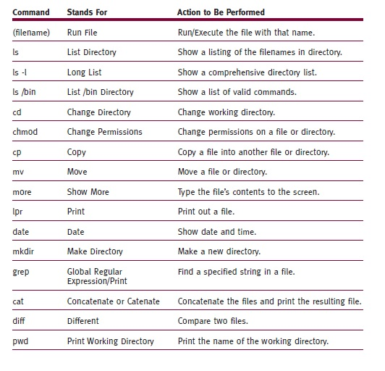
Linux: Command Line Interface
Notes:
https://en.wikipedia.org/wiki/Linux_kernel

Slide 48
Linux: Command Line Interface
http://www.masswerk.at/jsuix/
ls
ls –la
pwd
cd .
cd ..
man man
Notes:
https://en.wikipedia.org/wiki/Linux_kernel

Slide 49
Linux: Command Line Interface
http://www.masswerk.at/jsuix/
#!/bin/sh
mkdir BackUpFolder
cp *.txt BackUpFolder
ls -la BackUpFolder
Notes:
https://en.wikipedia.org/wiki/Linux_kernel

